Slide 1
Using Salesforce DX with Scratch org
Golden Hour
Amit Barnawal

Slide 2

About Me
Technical Architect @ Persistent Systems
Have 15+ Years of Experience in Software Developments & IT Solutions for Banking, Insurance, Finance, Healthcare and Telecom Industry
8+ Years in Salesforce
Currently working as Technical Architect for Kotak Bank.

Slide 3
Content
Salesforce DX
Dev Hub
Why Scratch Org
Scratch Org
Quiz
Notes:
Ref : https://www.freecodecamp.org/news/writing-good-commit-messages-a-practical-guide/

Slide 4
Introduction to Salesforce DX
Salesforce Developer Experience (DX) is a new way to manage and develop apps on the Lightning Platform across their entire life cycle. It brings together the best of the Lightning Platform to enable source-driven development, team collaboration with governance, and new levels of agility for custom app development on Salesforce.
It is a powerful command-line interface (CLI) removes the complexity of working with Salesforce org for development, continuous integration, and delivery.
SFDX is a command line tool but we can also use Visual studio plug-in to do the development

Slide 5
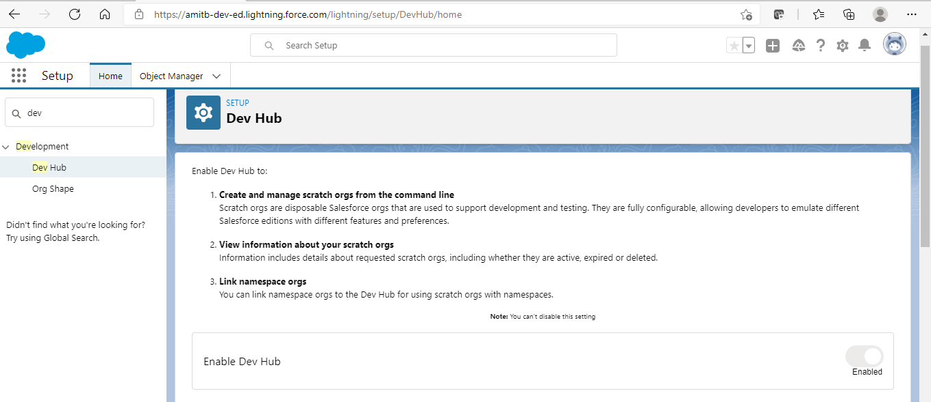
Developer Hub
What Is a Developer Hub Org?
A Developer Hub (Dev Hub) is the main Salesforce org that is used to create and manage scratch orgs. It stores all information related to scratch orgs.
In order to enable DevHub in developer edition / trial / production org / business org, first need to enable Devhub.
Notes:
Once Dev Hub is Enabled It can not be disabled

Slide 6
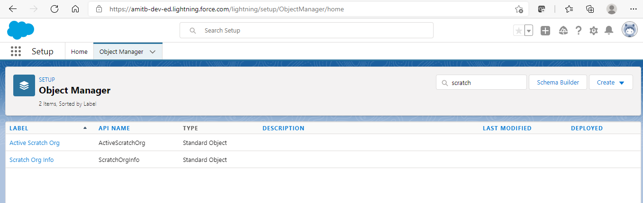
Developer Hub (Contd.)
Once Dev Hub is enabled new objects related to scratch org automatically gets visible in Dev Hub Org
Active Scratch Org
Scratch Org Info
Notes:
Active Scratch Org object basically consist of information about all the scratch orgs that are currently Active.
Scratch Org Info object consist of information about all scratch orgs that are created using this DevHub no matter whether they’re currently active or expired. It basically have the metadata of scratch orgs like:- Edition, Created Date, Expiration Date, Status etc.

Slide 7
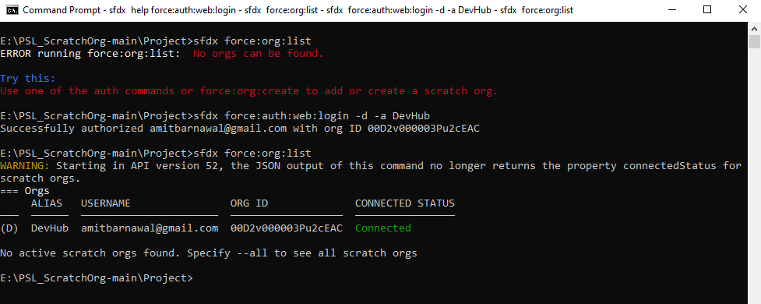
Developer Hub (Contd.)
Command to Authorize DevHub Org
sfdx force:auth:web:login -d -a DevHub

Slide 8
Why Scratch Org
In Large Enterprises major challenges are
Maintaining Sandbox
Refreshing Sandbox
Changeset based Deployment:
Changeset can be used only in connected environment.
Once deployment done, Information is lossed until we do manually noting down that this changeset contains this metadata.
Development using changesets to move code can be troubling for team working on same set of configurations because there is no going back.
Source of truth is always Org.

Slide 9
Why Scratch Org (Contd.)
ANT Migration Tool:
Using Ant metadata, we can deploy anywhere to anywhere no dependency on connected environment.
We always have meta data which can be stored in some source code management like Git/SVN or somewhere else.
Problem with ANT to get profile you have to get all components.
Need to create package.xml
The new “source of truth” for source-driven development is in the VCS (Version Control System) rather than in the production org. This means the configuration of the org exists outside the org. So experimental orgs can be easily created and tested without fear of disruption.
To overcome these challenges Salesforce came with New tool i.e. Scratch Org and Salesforce DX, which has no dependency on connected org & package.xml. Source of truth can always stay in VCS.

Slide 10
Scratch Org
What Is a Scratch Org?
Salesforce DX & Dev Hub enables us to use a new type of org called scratch org. A scratch org is a dedicated, configurable, and short-term Salesforce environment that we can quickly spin up when starting a new project, a new feature branch, or a feature test.
Designed to be ephemeral and easily recreated, scratch orgs are dedicated and configurable Salesforce environments that can quickly spin up for many different purposes.
Scratch Orgs are time bound and can be created for 1 Day to 30 Days. Default valur is 7 Days.
Scratch org can be configured with different Salesforce editions and with just the features and preferences we want.
Scratch org configuration file can be shared with team members. That way, Everyone can have the same basic org for development.
Features, settings, limits, and licenses determine what we refer to as an org’s shape of Scratch Org.
Command to view how many scratch orgs allocated to DevHub Org, and how many you remaining:
sfdx force:limits:api:display -u <Dev Hub username or alias>
Notes:
Scratch orgs can be your own personal development environment, or you can create headless scratch orgs for automated tests. You can spin up a new scratch org when you want to:
Start a new project.
Start a new feature branch.
Test a new feature.
Start automated testing.
Perform development tasks directly in an org.
Start from “scratch” with a fresh new org.

Slide 11
Scratch Org (Contd.)
Scratch Org Definition File:
The scratch org definition file is a blueprint for a scratch org. It mimics the shape of an org that you use in the development life cycle, such as sandbox, packaging, or production.
The settings and configuration options associated with a scratch org determine its shape, including:
Edition—The Salesforce edition of the scratch org, such as Developer, Enterprise, Group, or Professional.
Add-on features—Functionality that is not included by default in an edition, such as multi-currency.
Settings—Org and feature settings used to configure Salesforce products, such as Chatter and Communities.
By default, scratch orgs are empty. They don’t contain much of the sample metadata that we get whenwe sign up for an org, such as a Developer Edition org, the traditional way. Some of the things not included in a scratch org are:
Custom objects, fields, indexes, tabs, and entity definitions
Sample data, Sample Chatter feeds
Dashboards and reports
Workflows, Picklists
Profiles and permission sets
Apex classes, triggers, and pages

Slide 12
Scratch Org (Contd.)
Command to create scratch Org with scratch org definition file:
sfdx force:org:create -s -f config/project-scratch-def.json -a dreamhouse-org --durationdays 30
It takes few minutes and after scratch org creation we get Org Id and Username
Command to Open Scratch Org:
sfdx force:org:open
Notes:
sfdx force:org:create -f config/project-scratch-def.json -a dreamhouse-org1 --durationdays 30
Salesforce DX uses cached authentication tokens
Because we set the scratch org as default using the -s flag, the system remembers stores the authentication token and uses it to log in. The -s flag saves time from having to manually log in and remember passwords later.

Slide 13

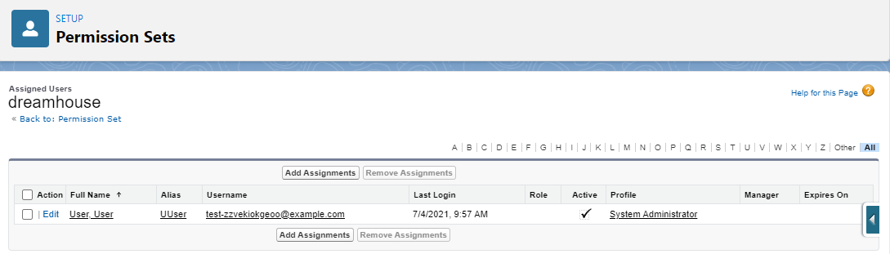
Scratch Org (Contd.)
We can assign permission set using command line
sfdx force:user:permset:assign -n Dreamhouse

Slide 14
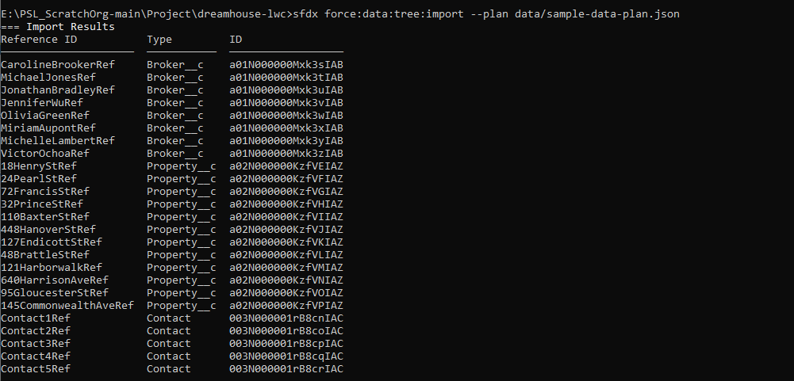
Scratch Org (Contd.)
Command to import Test data:
sfdx force:data:tree:import --plan data/sample-data-plan.json

Slide 15
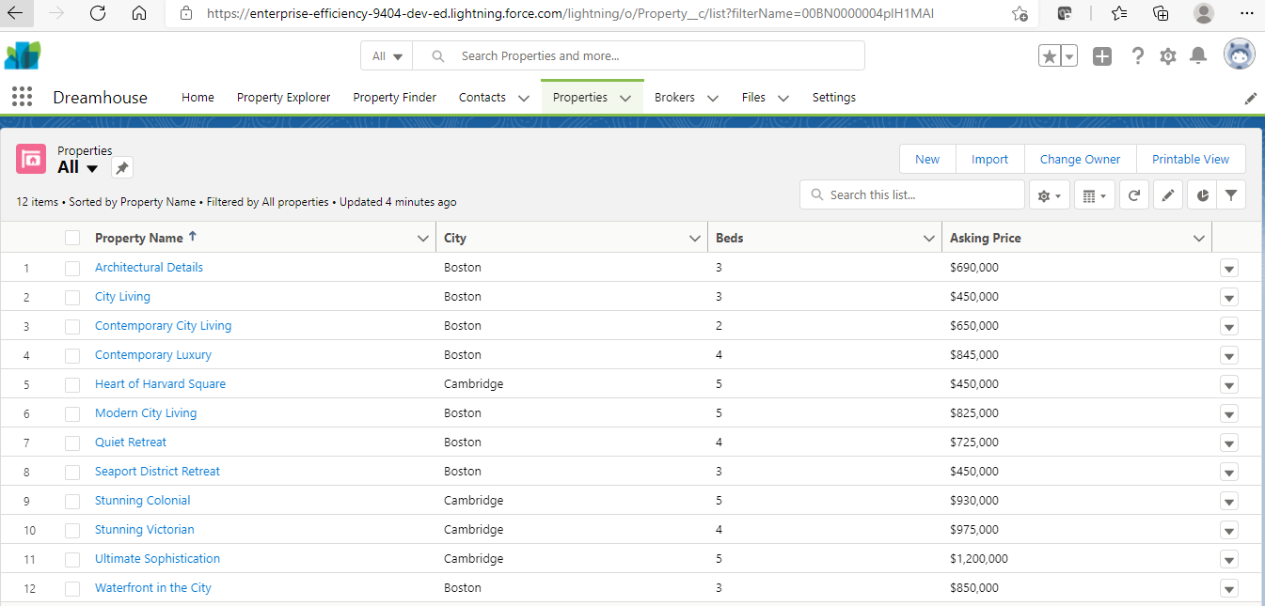
Scratch Org (Contd.)
Properties data after import in scratch org:

Slide 16
Scratch Org (Contd.)
Useful commands :
sfdx force:org:create -s -f config/project-scratch-def.json -a dreamhouse-org --durationdays 30
sfdx force:source:push
sfdx force:source:pull
sfdx force:org:open
sfdx force:auth:logout --targetusername my-hub-org

Slide 17
Quiz

Slide 18
Question - 1
Scratch Org can be created for ?
60 Days
30 Days
365 Days
50 Days

Slide 19
Question - 1
Scratch Org can be created for ?
60 Days
30 Days
35 Days
50 Days
Answer:
B. 30 Days
Scratch Org can be created from 1 to 30 Days,
By default Its created for 7 Days.

Slide 20
Question - 1
Which does not define Org Shape?
Features
Settings
Time
Licenses

Slide 21
Question - 1
Which does not define Org Shape?
Features
Settings
Time
Licenses
Answer:
C. Time
Features, Settings, Limits and Licenses define Org Shape.

Slide 22
Question - 1
Which org can work as DevHub?
Dev Sandbox
Full Copy Sandbox
Scratch Org
Enterprise Org

Slide 23
Question - 1
Which org can work as DevHub?
Dev Sandbox
Full Copy Sandbox
Scratch Org
Enterprise Org
Answer:
D. Enterprise Org
DevHub can be enabled on Developer, Enterprise, Unlimited, Performance Edition Orgs.

Slide 24
References:
https://developer.salesforce.com/docs/atlas.en-us.sfdx_dev.meta/sfdx_dev/sfdx_dev_intro.htm
https://www.jitendrazaa.com/blog/salesforce/getting-started-with-salesforce-dx-salesforce-developer-experience/
https://wilsonmar.github.io/salesforce-dx/
Set Up the Project on Your Local Machine Unit | Salesforce Trailhead

Slide 25
Thank You

